Slide 1
Prefetch Procrastinator for Android

Slide 2
Project Description
Prefetched contents at the time of launch gets rendered quickly and improves user experience
Unavoidable data usage

Slide 3


Story of a Developer and a User
Developer
User

Slide 4
I will make a Super Cool app.
The app should be fast and have no latency.
How do I make it Fast?
Solution: Pre-fetch.
Developer

Slide 5
Installs the Cool app.
Uses it for few days.
Reaction: Wow! This app is so fast and useful.
User

Slide 6

A Month Later...
Reaction:
This App Used Up All my LTE data. Uninstall !!!!
I’ll search for a new App.
User

Slide 7

Developer

Slide 8

Our Aim
Developer

Slide 9
Design
Android Common Pattern
Activity 1{
var1 <= networkFetch(url1)
var2 <= networkFetch(url2)
startActivity2(var2)
}
Activity 2{
textView.setText(var2)
}

Slide 10
Design
Detect n/w prefetch variables
n/w call for prefetch variable
Use of prefetch variable (var2) detected
Store the URL (url2) and corresponding variable (var2)
No
Connected to Wi-fi
Yes
Execute network call for prefetch

Slide 11
Method – Find Patterns
Most common pattern (Screenshot of a code snippet explaining pattern)
Prefetched variables are being used in other activities

Slide 12
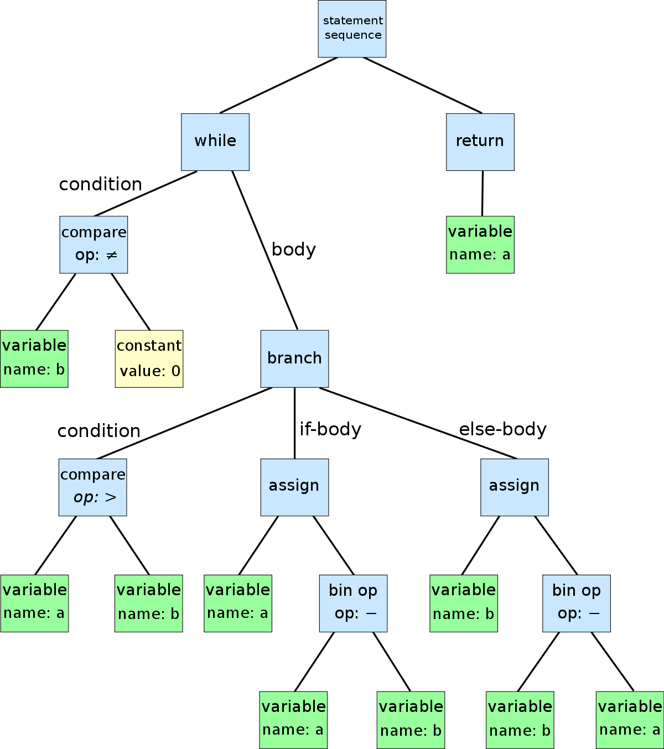
Method – Static Analysis: ASTs

Slide 13
Method – Static Analysis: General
Track Intent Calls
Created a new AsyncTask with the respective URL that will executed procrastinated calls
This AsyncTask object will be called and executed when the new activity using the prefetch variable is executed
No
Prepare a list of all the variables passed in intent
Is variable a network call?
Instrument the network call with procrastination condition
Yes

Slide 14

Method – Track User Movements
Detect n/w prefetch variables
n/w call for prefetch variable
Use of prefetch variable (var2) detected
Store the URL (url2) and corresponding variable (var2)
No
Connected to Wi-fi
ViewPrefetch
Correlation
Yes
Execute network call for prefetch

Slide 15
View Prefetch Correlation
Key Limitation: General User Adaptability
Proposed Solution: Perform Study of Prefetch Necessity using VPC.
Inspired from Background Foreground Correlation
For each time a prefetch is performed, evaluate how many times a view is invoked.
Provides developer with whether prefetch is really required for a given view.
Implemented as a part of the package.

Slide 16
Approach & Implementation
Implement a Simple POC Weather App, with the prefetch pattern and 2 screens.
First Screen – Prefetch,
Second Screen – Use the prefetch data.
Implement Instrumentation and Procrastination tool for desktop.
Implement Measurements Library for data usage and VPC measurement.
Implement Android Procrastination Library.

Slide 17
Evaluation Methodology
Provide it to 4 users
Collect data for 7 days
2 Users – Prefetch App , 2 Users – Prefetch Procrastinated App
Track view pre-fetch correlation.
Track network data usage of app for each day per user.

Slide 18
Results

Slide 19
Limitations
Limited to one pattern only.
Limited to Java source code analysis rather than bytecode
Not yet tested on Post data.
Instrumentation process requires some developer involvement.

Slide 20
Potential Future Work
Implement for POST based pre-fetch.
Analyze at Byte Code level
Identify more patterns
Test on more applications.

Slide 21
Conclusion
This work definitely suggests that there is some scope tracking user movements and using it for procrastination
(Insert some key results)
With our design, it is possible to procrastinate HTTP POST method
Bytecode instrumentation would make the static analysis more generalized
In this work, we are targeting a fundamental network design in Android, hence with minor modification it should work with various network libraries.

